Slide 1

AI QUORIDOR GAME PROJECT
Advanced Machine Learning & Multi-Platform Integration
Author: Đỗ Đoàn Huy Hoàng – 2025

Slide 2
📑 Table of Contents
Project Overview
Game Rules & Strategies
Q-Learning Algorithm
Specialized AI Styles
Minimax + Alpha-Beta Pruning
Decision Tree & Entropy Analysis
A* Pathfinding Algorithm
Hybrid AI Architecture
Voice & Chat Integration
Rasa & Gemini APIs
TTS & STT Systems
Local Python AI
Dynamic Switching
Training & Self-Play
Testing Framework
Developer Tools
Performance Results
Conclusion & Roadmap
Thank You

Slide 3




Project Overview: A Symphony of Systems
Our AI Quoridor project is an advanced demonstration of integrated machine learning, featuring a robust architecture across four core components, each meticulously designed for performance and adaptability.
Game Engine: Unity 3D
AI System: Q-Learning
A 9x9 board, enabling seamless Player vs. AI interactions with intuitive controls and responsive design.
Features 6 distinct AI styles, a Minimax fallback, and handles over 13,118 game states for complex decision-making.
Communication: Rasa + Gemini
Developer Tools
Integrates 5 Text-to-Speech/Speech-to-Text providers for natural language interaction and enhanced user experience.
Includes a comprehensive training manager, performance tester, and real-time monitor for efficient development and debugging.

Slide 4
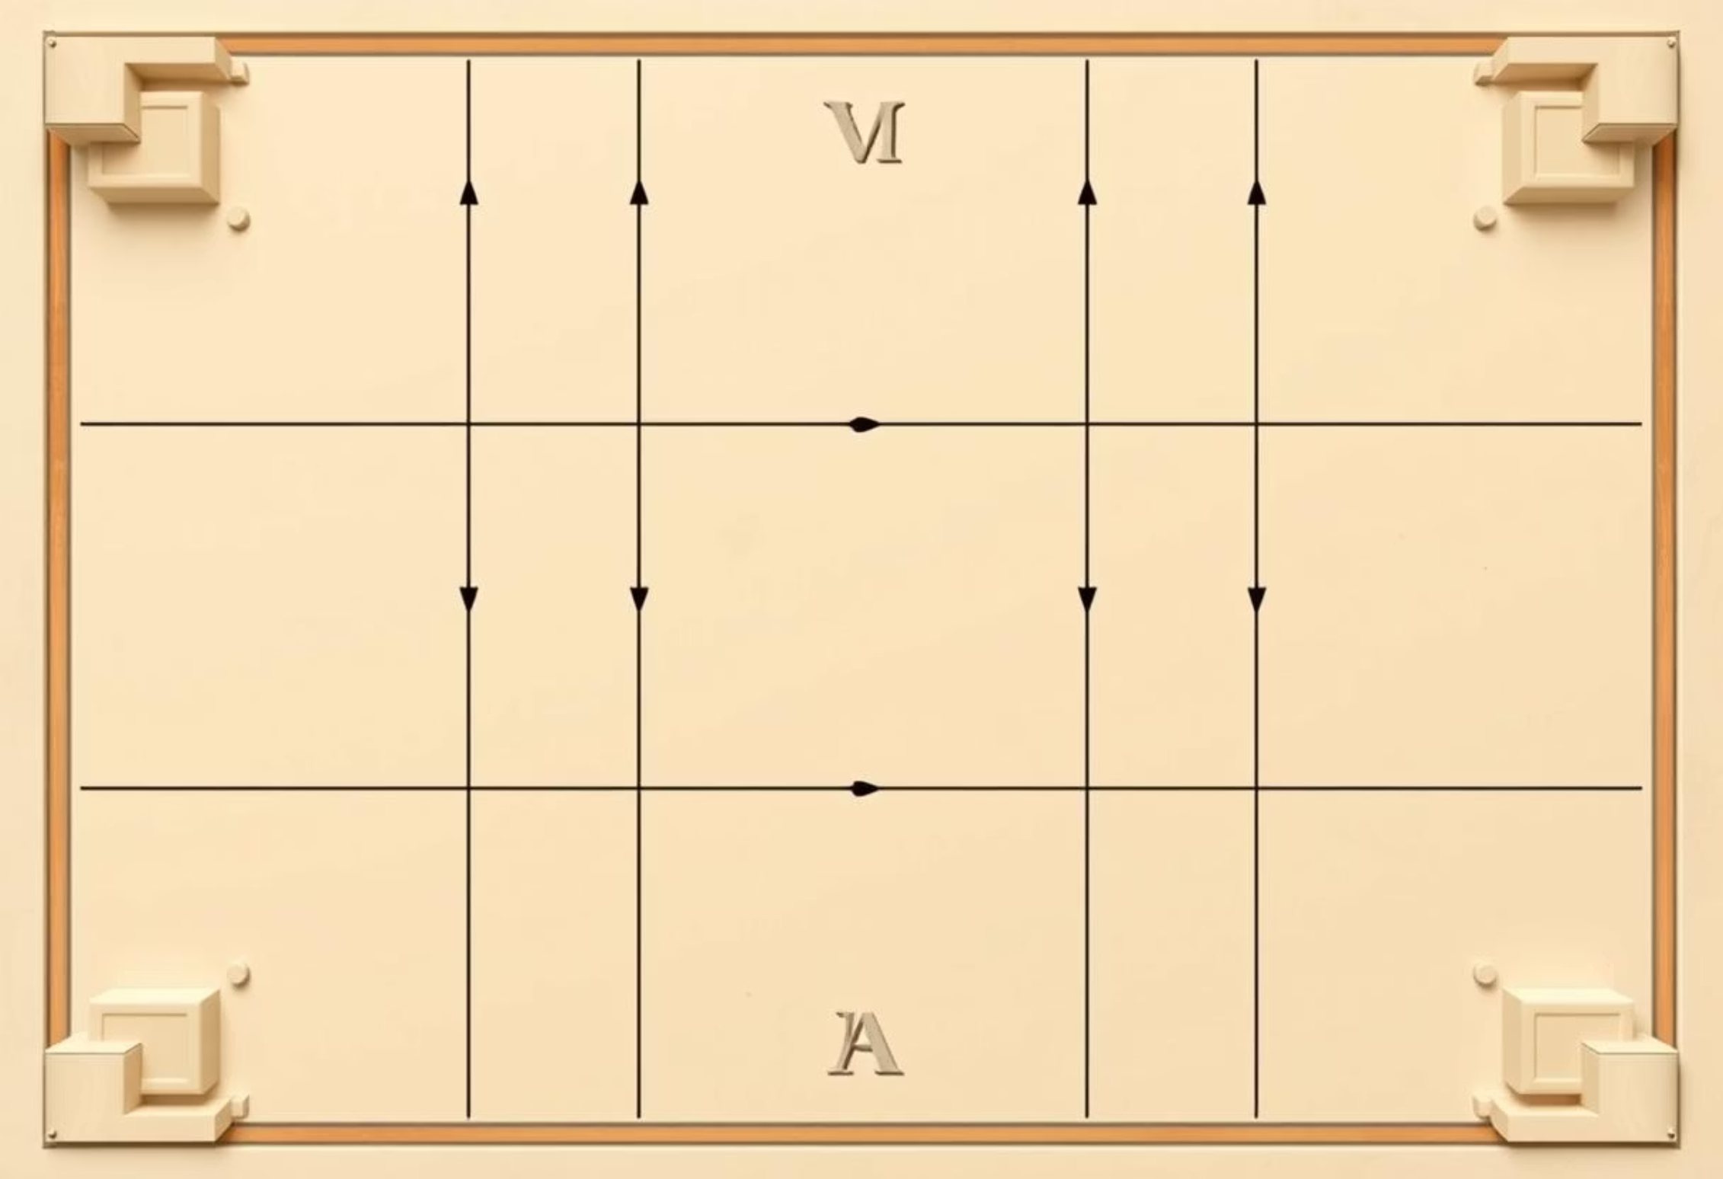
Mastering Quoridor: Rules and Strategies
Basic Rules
Advanced Tactics
Movement: Pawns move one square orthogonally, unable to jump over walls.
Blocking Strategy: Judiciously placing walls to funnel opponent while maintaining your path.
Wall Placement: Place 10 walls to block opponent, ensuring at least one path remains open.
Racing: Prioritizing pawn movement to the goal when a clear path is available.
Win Condition: First player to reach any square in the opponent's starting row wins.
Maze Building: Creating complex wall structures to significantly delay the opponent.
Constraints: Walls cannot completely block a path to the goal.
Center Control: Dominating central squares for flexible movement and wall placement options.
Visual representation of the 9x9 Quoridor game board.

Slide 5


Q-Learning: The Brain of Our AI
QLearningAgent Class
Key Metrics & Convergence
class QLearningAgent: def __init__(self, alpha, gamma, epsilon): self.q_table = {} self.alpha = alpha # Learning rate self.gamma = gamma # Discount factor self.epsilon = epsilon # Exploration-exploitation trade-off def get_q_value(self, state, action): return self.q_table.get((state, action), 0.0) def update_q_value(self, state, action, reward, next_state): old_value = self.get_q_value(state, action) next_max = max([self.get_q_value(next_state, a) for a in ALL_ACTIONS]) new_value = old_value + self.alpha * (reward + self.gamma * next_max - old_value) self.q_table[(state, action)] = new_value def choose_action(self, state, available_actions): if random.uniform(0, 1) < self.epsilon: return random.choice(available_actions) # Explore else: q_values = {action: self.get_q_value(state, action) for action in available_actions} max_q = max(q_values.values()) best_actions = [action for action, q_val in q_values.items() if q_val == max_q] return random.choice(best_actions) # Exploit
State Space: >13,118 unique game states captured.
Episodes Trained: 1,000 episodes for robust learning.
Epsilon (ε) Decay: 0.995 gradually decreasing to 0.1 for balanced exploration.
Learning Rate (α): Set at 0.1 for optimal weight updates.
Discount Factor (γ): At 0.99, prioritizing future rewards.
Convergence: Achieved around Episode ~800, indicating stable learning.

Slide 6






Diverse AI Personalities: The 6 AI Styles
AGGRESSIVE
Wall Usage: 20%Strategy: Focuses on rapid pawn advancement.Q-table: Aggressive_Q.dat
DEFENSIVE
Wall Usage: 80%Strategy: Prioritizes blocking opponent's path.Q-table: Defensive_Q.dat
WALL MASTER
Wall Usage: 95%Strategy: Constructs intricate mazes.Q-table: WallMaster_Q.dat
SPEED RUNNER
Wall Usage: 5%Strategy: Pure pawn rush, avoids walls.Q-table: SpeedRunner_Q.dat
TACTICAL
Wall Usage: 60%Strategy: Balances pawn movement with strategic wall placement.Q-table: Tactical_Q.dat
BALANCED
Wall Usage: 50%Strategy: Adapts to opponent, dynamic play.Q-table: Balanced_Q.dat

Slide 7
Minimax with Alpha-Beta Pruning: Strategic Depth
FindBestMove() Function
Evaluation Criteria
def find_best_move(board, depth, alpha, beta, maximizing_player): if depth == 0 or is_game_over(board): return evaluate_board(board) if maximizing_player: max_eval = -infinity for move in get_possible_moves(board): new_board = apply_move(board, move) eval = find_best_move(new_board, depth - 1, alpha, beta, False) max_eval = max(max_eval, eval) alpha = max(alpha, eval) if beta <= alpha: break # Beta cut-off return max_eval else: min_eval = infinity for move in get_possible_moves(board): new_board = apply_move(board, move) eval = find_best_move(new_board, depth - 1, alpha, beta, True) min_eval = min(min_eval, eval) beta = min(beta, eval) if beta <= alpha: break # Alpha cut-off return min_eval
Distance to Goal: Prioritizes moves that bring the pawn closer to the opponent's winning row.
Wall Advantage: Assesses the strategic value of current wall placements, considering both offensive and defensive potential.
Mobility: Evaluates the number of available moves for the current player, favoring positions with greater freedom.
Blocking Potential: Analyzes how effectively walls can restrict opponent movement or create dead ends.
Minimax, enhanced with Alpha-Beta Pruning, allows our AI to look multiple moves ahead, evaluating potential outcomes and selecting the optimal strategy while significantly reducing computational overhead.

Slide 8
Decision Tree & Entropy: Adaptive Action Selection
DecisionTreeClassifier Logic
CalculateEntropy() & Softmax()
class DecisionTreeClassifier: def __init__(self, max_depth=None): self.max_depth = max_depth self.tree = None def fit(self, X, y): # Build the decision tree recursively self.tree = self._build_tree(X, y, 0) def _build_tree(self, X, y, depth): if depth == self.max_depth or len(set(y)) == 1: return LeafNode(y) best_feature, best_threshold = self._find_best_split(X, y) if best_feature is None: return LeafNode(y) left_X, left_y, right_X, right_y = self._split_data(X, y, best_feature, best_threshold) left_child = self._build_tree(left_X, left_y, depth + 1) right_child = self._build_tree(right_X, right_y, depth + 1) return InternalNode(best_feature, best_threshold, left_child, right_child) def predict(self, X): return [self._traverse_tree(x, self.tree) for x in X] def _traverse_tree(self, x, node): if isinstance(node, LeafNode): return node.predict() if x[node.feature] <= node.threshold: return self._traverse_tree(x, node.left_child) else: return self._traverse_tree(x, node.right_child)
def calculate_entropy(labels): # Calculate Shannon entropy for a list of labels # Used for determining feature splits in decision tree unique_labels, counts = np.unique(labels, return_counts=True) probabilities = counts / len(labels) entropy = -np.sum(probabilities * np.log2(probabilities + 1e-9)) # Add epsilon for log(0) return entropydef softmax(x): # Applies softmax function to an array of values # Used to convert Q-values into probabilities for action selection e_x = np.exp(x - np.max(x)) # For numerical stability return e_x / e_x.sum(axis=0)
Our AI employs Decision Tree logic, leveraging Entropy calculations to discern the most informative features for splitting game states. This, combined with the Softmax function, enables the AI to adaptively select actions based on the probability distribution of Q-values, making its play highly dynamic and unpredictable.

Slide 9


A* Pathfinding: Guiding the Pawn's Journey
AStarPathfinding Class
class AStarPathfinding: def __init__(self, board_state): self.board = board_state def find_path(self, start, goal): open_set = {start} came_from = {} # To reconstruct path g_score = {node: float('inf') for node in all_nodes_on_board} g_score[start] = 0 f_score = {node: float('inf') for node in all_nodes_on_board} f_score[start] = self.heuristic(start, goal) while open_set: current = min(open_set, key=lambda node: f_score[node]) if current == goal: return self.reconstruct_path(came_from, current) open_set.remove(current) for neighbor in get_neighbors(current, self.board): tentative_g_score = g_score[current] + self.cost(current, neighbor) if tentative_g_score < g_score[neighbor]: came_from[neighbor] = current g_score[neighbor] = tentative_g_score f_score[neighbor] = g_score[neighbor] + self.heuristic(neighbor, goal) if neighbor not in open_set: open_set.add(neighbor) return None # No path found def heuristic(self, node, goal): # Manhattan distance or Euclidean distance return abs(node.x - goal.x) + abs(node.y - goal.y) def cost(self, from_node, to_node): # Cost of moving between nodes (e.g., 1 for adjacent squares) return 1
Core Components & Applications
Open Set: Nodes to be evaluated.
Closed Set: Nodes already evaluated.
g-cost: Cost from start to current node.
h-cost: Heuristic cost from current node to goal.
f-cost: Total estimated cost (g + h).
A* Pathfinding is crucial for our AI, not only for path validation (ensuring no wall completely blocks the path) but also for calculating a precise distance score to the goal, a key factor in the AI's decision-making process.

Slide 10



Hybrid AI Architecture: Robustness and Flexibility
Primary: Q-Learning
Dynamic Switching Logic
Fallback: Minimax
Utilized for general gameplay, leveraging learned Q-values for efficient and nuanced decision-making in most scenarios.
The system intelligently switches to Minimax when Q-Learning encounters states with high uncertainty or requires deeper foresight (e.g., end-game scenarios or critical wall placements).
Provides a powerful, exhaustive search when optimal decision-making is critical, especially in complex or constrained board states.
Our AI architecture intelligently combines the adaptability of Q-Learning with the strategic depth of Minimax. This hybrid approach ensures both robustness in diverse game situations and flexibility to handle exceptionally complex states.

Slide 11



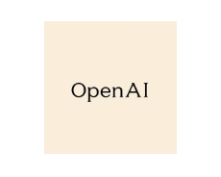
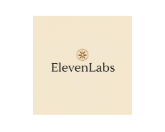

Voice & Chat System: Seamless Interaction
ChatService Class
Text-to-Speech (TTS) Providers
class ChatService: def __init__(self, rasa_url, gemini_api_key): self.rasa_url = rasa_url self.gemini_api_key = gemini_api_key async def send_message_to_rasa(self, user_message, sender_id="user1"): payload = {"sender": sender_id, "message": user_message} async with aiohttp.ClientSession() as session: async with session.post(f"{self.rasa_url}/webhooks/rest/webhook", json=payload) as response: return await response.json() async def send_message_to_gemini(self, user_message): # Placeholder for Gemini API call # In a real implementation, this would involve specific Gemini client library usage return {"text": f"Response from Gemini for: {user_message}"}
Speech-to-Text (STT) Features
Multi-language Support: Accurately transcribes speech across various languages.
Real-time Processing: Converts speech to text with minimal latency for fluid conversations.
Noise Reduction: Filters background noise for clearer and more accurate transcription.
Our comprehensive voice and chat system, powered by Rasa and Gemini, offers a highly interactive user experience. With support from multiple TTS providers and advanced STT features, communication with the AI is natural and efficient.

Slide 12

🗣️ Rasa Chatbot Integration
Key Method: SendMessageToRasa()
// SendMessageToRasa() - sends JSON payload to local Rasa serverpublic async Task<string> SendMessageToRasa(string userInput){ var payload = new { sender = "user", message = userInput }; var content = new StringContent(JsonConvert.SerializeObject(payload), Encoding.UTF8, "application/json"); var response = await httpClient.PostAsync("http://localhost:5005/webhooks/rest/webhook", content); return await response.Content.ReadAsStringAsync();}
Rasa Server Details
Natural Language Understanding (NLU): Processes and understands user input.
Dialogue Management: Manages conversation flow and decides the AI's response.
REST Webhook Integration: Facilitates seamless communication between our application and the Rasa server.
This integration enables our AI to understand and respond to user queries in a natural, conversational manner, providing a truly interactive experience within the Quoridor game.

Slide 13
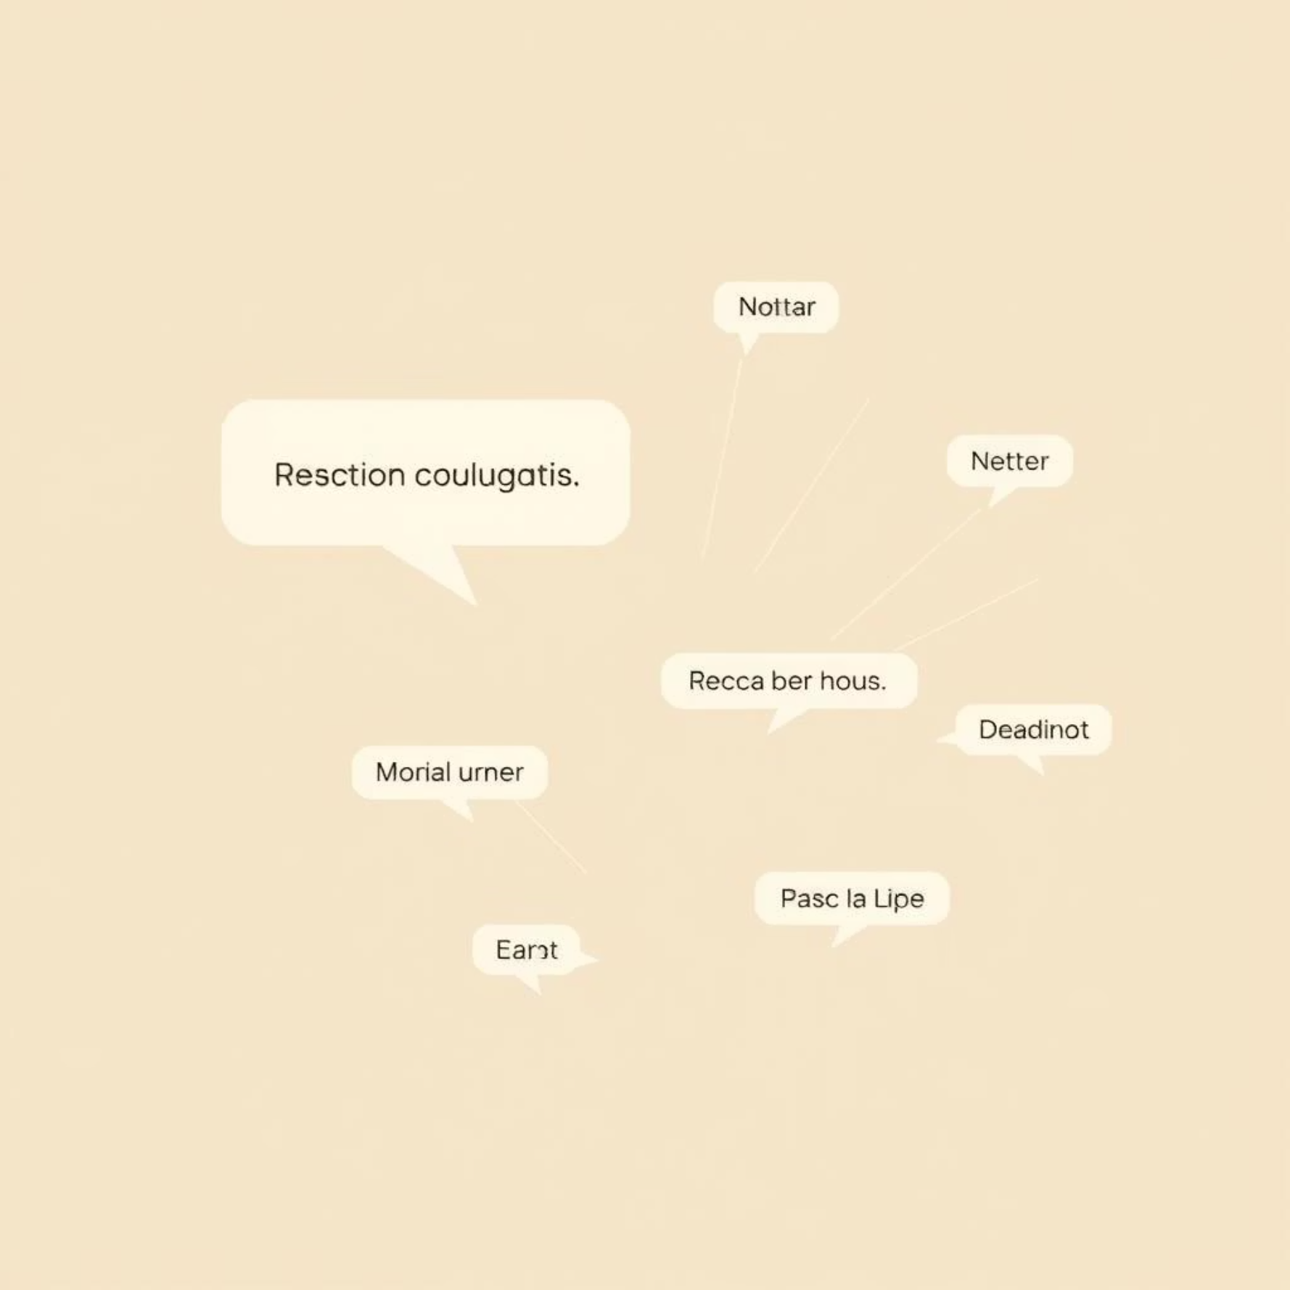
🌐 Gemini API Integration
Core Method: SendMessageToGemini()
// SendMessageToGemini() - Sends user input to Gemini APIpublic async Task<string> SendMessageToGemini(string input){ var request = new { contents = new[] { new { role = "user", parts = new[] { new { text = input } } } } }; var response = await httpClient.PostAsJsonAsync("https://gemini.googleapis.com/v1beta/models/gemini-1.5-flash:generateContent", request); var result = await response.Content.ReadAsStringAsync(); return ExtractTextFromGeminiResponse(result);}
Key Capabilities & Model
Advanced Generative Chatbot: Gemini excels in natural, human-like conversations.
Multi-Turn Dialogue: Supports complex, ongoing conversations with contextual understanding.
Bilingual Fluency: Handles both Vietnamese and English seamlessly.
Rasa Fallback: Acts as a robust backup if Rasa does not provide a response.
Our integration leverages the `gemini-1.5-flash` model for its high performance and low latency, ensuring prompt and context-aware responses in all interactions.

Slide 14









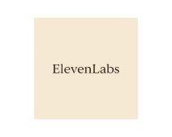
🔊 Multi-Platform TTS System
Implementation: Local TTS with pyttsx3
TTS Processing Flow
# Python Local TTS using pyttsx3import pyttsx3def speak(text): engine = pyttsx3.init() engine.say(text) engine.runAndWait()
Input Text
AI/Chatbot Response
Choose Provider
Local or Cloud TTS
Our Multi-Platform Text-to-Speech (TTS) System converts AI and chatbot responses into natural-sounding speech, ensuring a seamless and engaging user experience. It supports a diverse range of 5 TTS providers, with intelligent fallback logic to guarantee consistent performance.
Generate Audio
WAV/MP3 File
Output to User
Key Benefits
Through speakers
Fast Response: Prioritizes local TTS for rapid audio generation.
Cloud Fallback: Automatically switches to cloud providers if needed.
Supported TTS Providers
Voice Customization: Offers advanced options like voice cloning for personalized interactions.

Slide 15





🐍 Python Local AI System (Offline Mode)
Offline Operation
Local Deployment
Ensures continuous functionality without internet access.
Built with Python and Flask for on-device processing.
Enhanced Privacy
Independent Training
Keeps sensitive data secure and processed locally.
Allows for custom updates and model improvements.
Flask Server Code Example
System Overview
# Flask-based Local AI Endpointfrom flask import Flask, request, jsonifyapp = Flask(__name__)@app.route('/ai-response', methods=['POST'])def respond(): user_input = request.json['message'] return jsonify({'response': "This is your local AI reply to: " + user_input})if __name__ == '__main__': app.run(port=8080)Methods:• GetAIResponse() – generates reply from local model• TrainAI() – update knowledge from dialogue logs
Our local AI system is a Python-Flask application designed for robust offline performance. It serves as a critical backup, ensuring the game's AI remains functional even if Rasa and Gemini services are unavailable.
Local AI system built using Python + Flask
Runs without internet, ensures privacy
Can be trained and updated independently
Used as backup if Rasa & Gemini are unavailable
Key Benefits
Offline & Fast: Provides immediate responses without network latency.
Custom Training Possible: Adaptable to specific game scenarios or AI personalities.
Works Well with Local TTS: Seamlessly integrates with our local Text-to-Speech solutions for a complete offline experience.

Slide 16
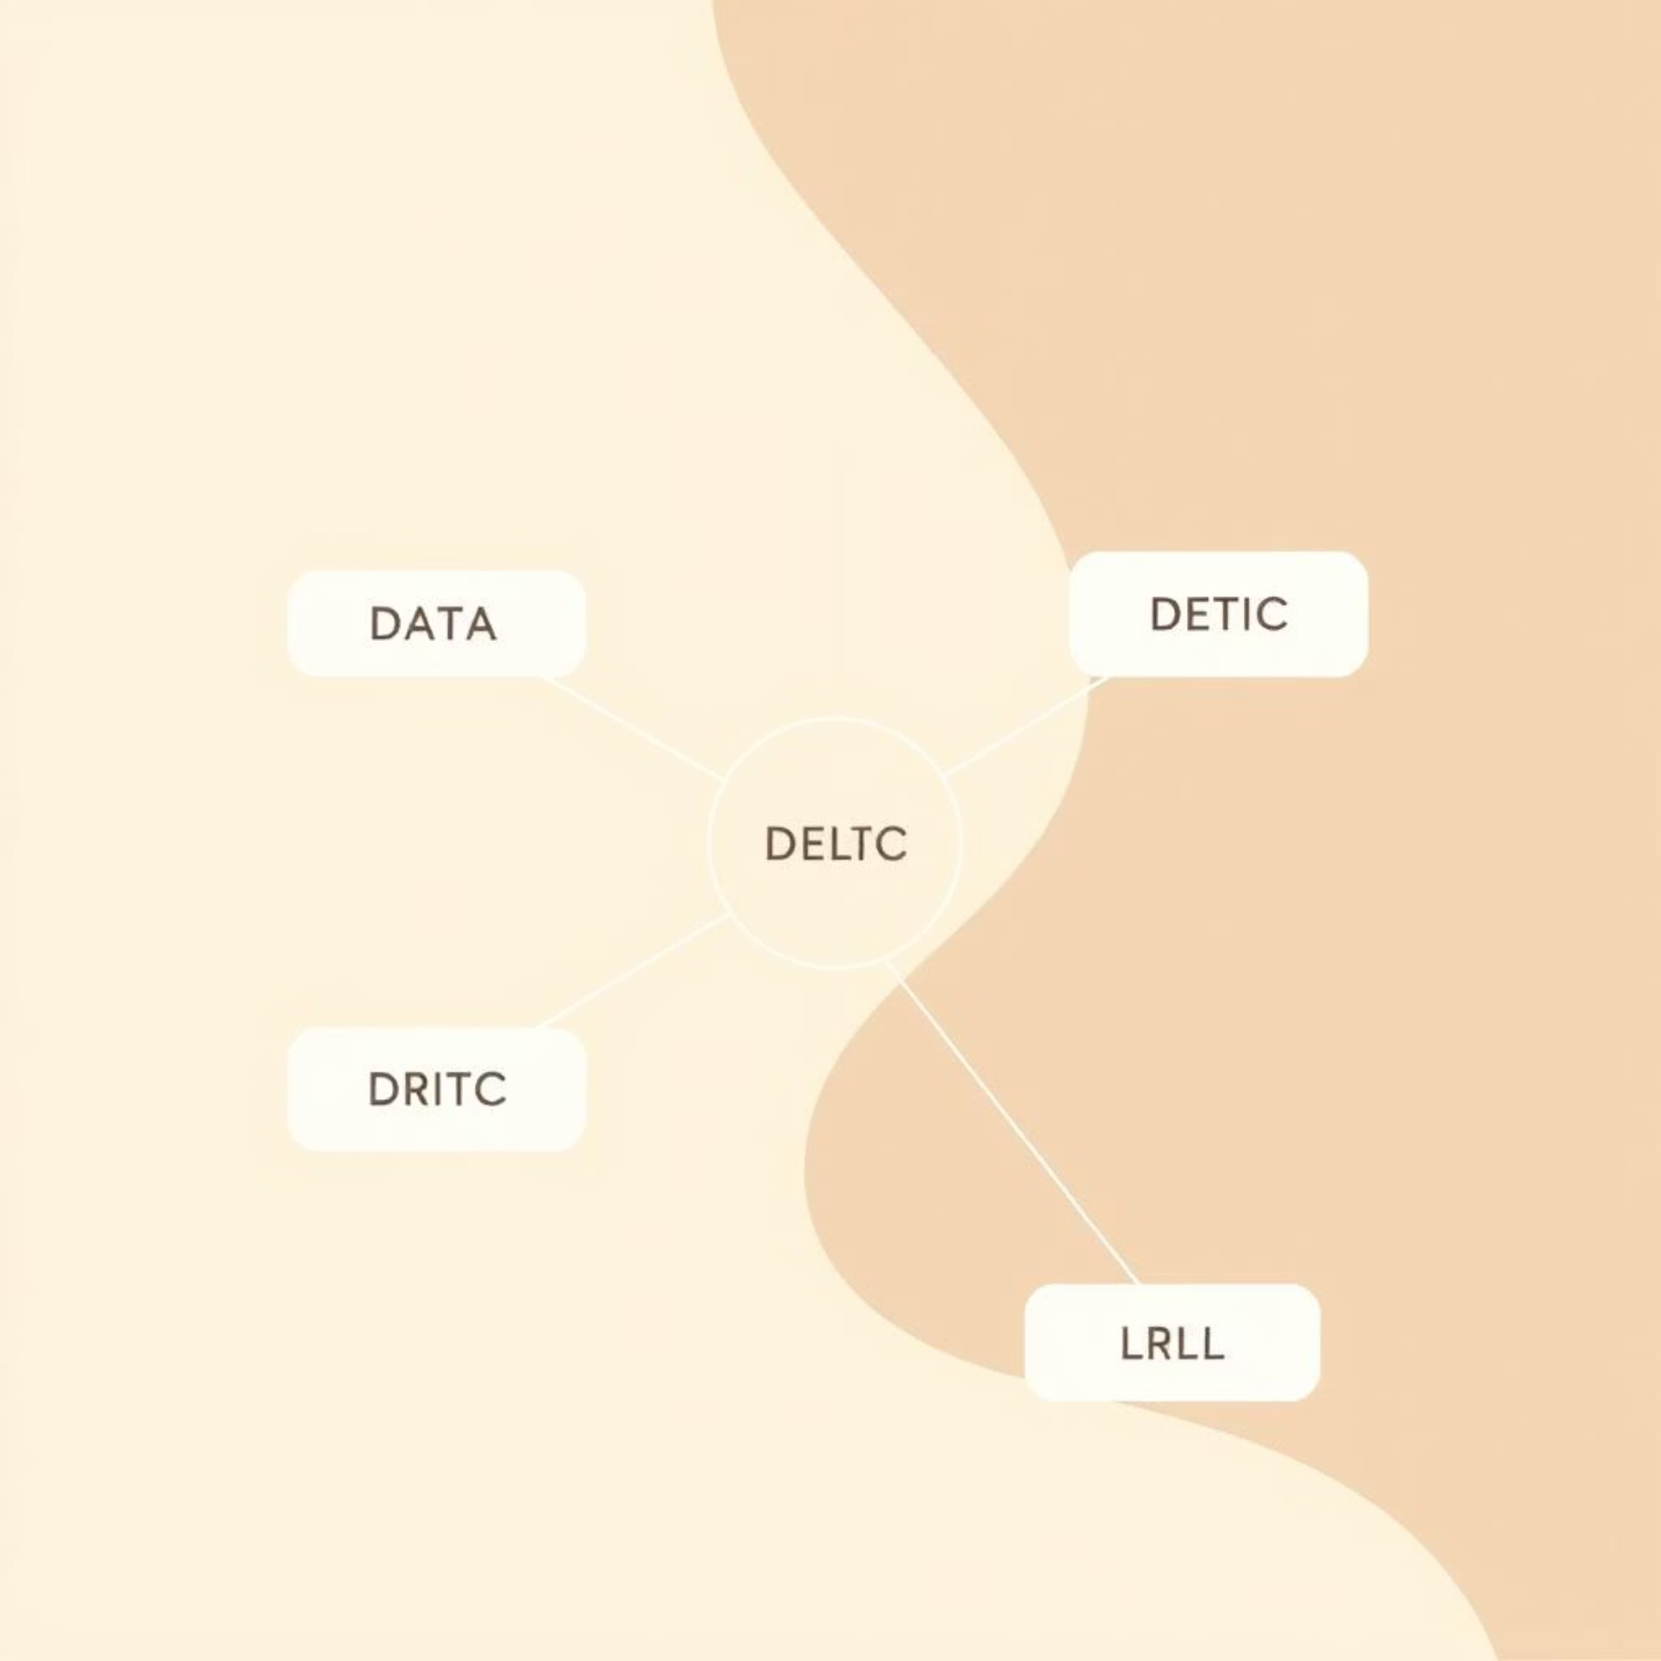
🔄 Dynamic AI, TTS & Language Switching
Our project features a highly modular system capable of dynamically switching between different AI modules, voice services, and languages. This design ensures exceptional reliability, redundancy, and seamless multilingual functionality, providing a robust and flexible user experience.
Switching Logic Breakdown
AI Logic Prioritization
TTS Provider Fallback
Q-Learning → Minimax (if untrained)
Local → Cloud (Google → Azure → OpenAI → ElevenLabs)
Ensures optimal strategy or a reliable fallback when learning is incomplete.
Prioritizes fast, local synthesis with cloud redundancy for uninterrupted audio.
Chatbot Service Hierarchy
Language Toggle
Rasa → Gemini → Local AI
Vietnamese ↔ English
Optimizes for rich, contextual conversations while ensuring offline capability.
Allows users to seamlessly switch communication languages on the fly.
Code Example: C# Logic Switching
public string GetBestResponse(string input){ string reply = TryRasa(input); if (string.IsNullOrEmpty(reply)) reply = TryGemini(input); if (string.IsNullOrEmpty(reply)) reply = CallLocalPythonAI(input); return reply;}
The C# code snippet demonstrates the core logic for intelligent chatbot response switching. It first attempts to get a response from the Rasa server. If Rasa doesn't provide a valid reply, it falls back to the Gemini API. As a final contingency, if both online services are unavailable, the system invokes the local Python AI, ensuring a response is always generated. This layered approach guarantees robust performance and high availability, adapting to varying network conditions and service statuses.

Slide 17





🎤 Speech-to-Text & Real-Time Voice Recognition
Our advanced STT system allows players to interact with the AI using natural language, providing a seamless and intuitive gaming experience. It's built for accuracy and speed, even in varying linguistic environments.
Key Capabilities
Code Sample: Voice Processing
Players speak directly to the AI system
# Audio input → Transcription → Responsedef process_voice_input(audio): text = speech_to_text(audio) # Real-time STT response = ai_chatbot(text) # AI processes command speak(response) # TTS generates audio
Real-time transcription with command recognition
Support for multiple languages (🇻🇳 Vietnamese, 🇺🇸 English)
Integrated with noise cancellation & voice filters
Processing Pipeline
User Voice
STT Engine
AI Response
TTS Output

Slide 18
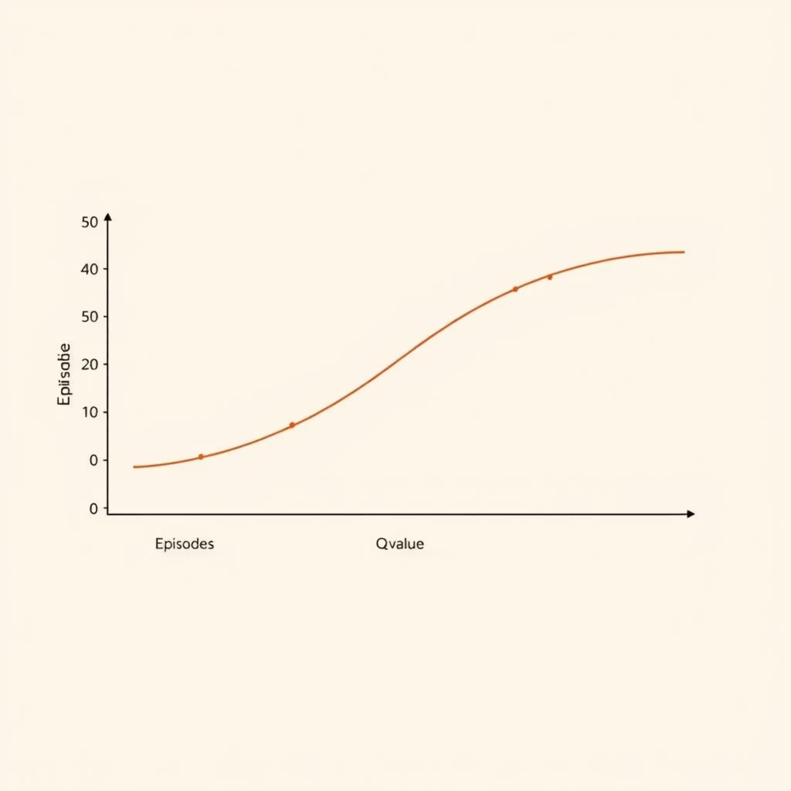

🏋️ Reinforcement Learning via Self-Play
Our AI agents are primarily trained through a robust self-play system, leveraging Q-Learning to iteratively refine their strategic decision-making. This autonomous training mechanism ensures continuous improvement and adapts to various game scenarios, with periodic Q-table saves to preserve learned policies.
Initialize Q-Table
Start with an empty Q-table to begin the learning process.
Loop Episodes
Run through thousands of game episodes for extensive training.
Agents Play
Two AI agents play against each other, simulating real games.
Update Q-Values
Adjust reward values after each move based on game outcomes.
Save Q-Table
Periodically save the Q-table to persist learned policies.
Training Statistics
Code Snippet: Self-Play Loop
Episodes: 1,000State Space: 13,118+ observed statesFinal ε (Exploration Rate): 0.1Convergence Point: ~Episode 800Duration: ~15 minutes (on a standard CPU)
IEnumerator RunSelfPlayTraining(){ for (int episode = 0; episode < 1000; episode++) { PlayOneGame(); if (episode % 100 == 0) SaveQTable(); epsilon *= 0.995f; // Decay exploration rate }}
Exploration-Exploitation Balance
The epsilon decay ensures the AI initially explores many strategies and then progressively focuses on optimal ones as training advances.

Slide 19





🧪 Comprehensive AI Testing & Validation Suite
Our comprehensive testing and validation suite is designed to ensure the accuracy, stability, and performance of the AI logic at every stage. It includes a robust set of automated tests that run after each training session or code update, guaranteeing the integrity of our AI models.
Test Coverage Highlights
Example Test Function (C#)
Decision Tree Strategies
[Test]public void TestDecisionTreePrediction(){ // Simulate a game state var input = new GameState { PlayerPosition = new Point(0, 0), OpponentPosition = new Point(8, 8), WallsPlaced = 5, // ... more game state details }; // Predict the AI's next move or action var result = decisionTreeClassifier.Predict(input); // Assert that a valid result is returned Assert.IsNotNull(result, "Decision tree prediction should not be null."); Assert.IsInstanceOf(result, "Prediction should be a valid Move object."); // Further assertions can check the quality/validity of the move Assert.IsTrue(result.IsValid(input), "Predicted move must be valid for the given state.");}
Verification of optimal and logical decision paths.
Entropy & Softmax Distribution
Validation of probabilistic choice distributions and randomness.
Feature Extraction Validity
Ensuring correct identification and processing of game state features.
Path Evaluation Accuracy
Confirmation of pawn movement and wall placement pathfinding accuracy.
Minimax vs Q-Learning
Comparative performance analysis between different AI paradigms.

Slide 20

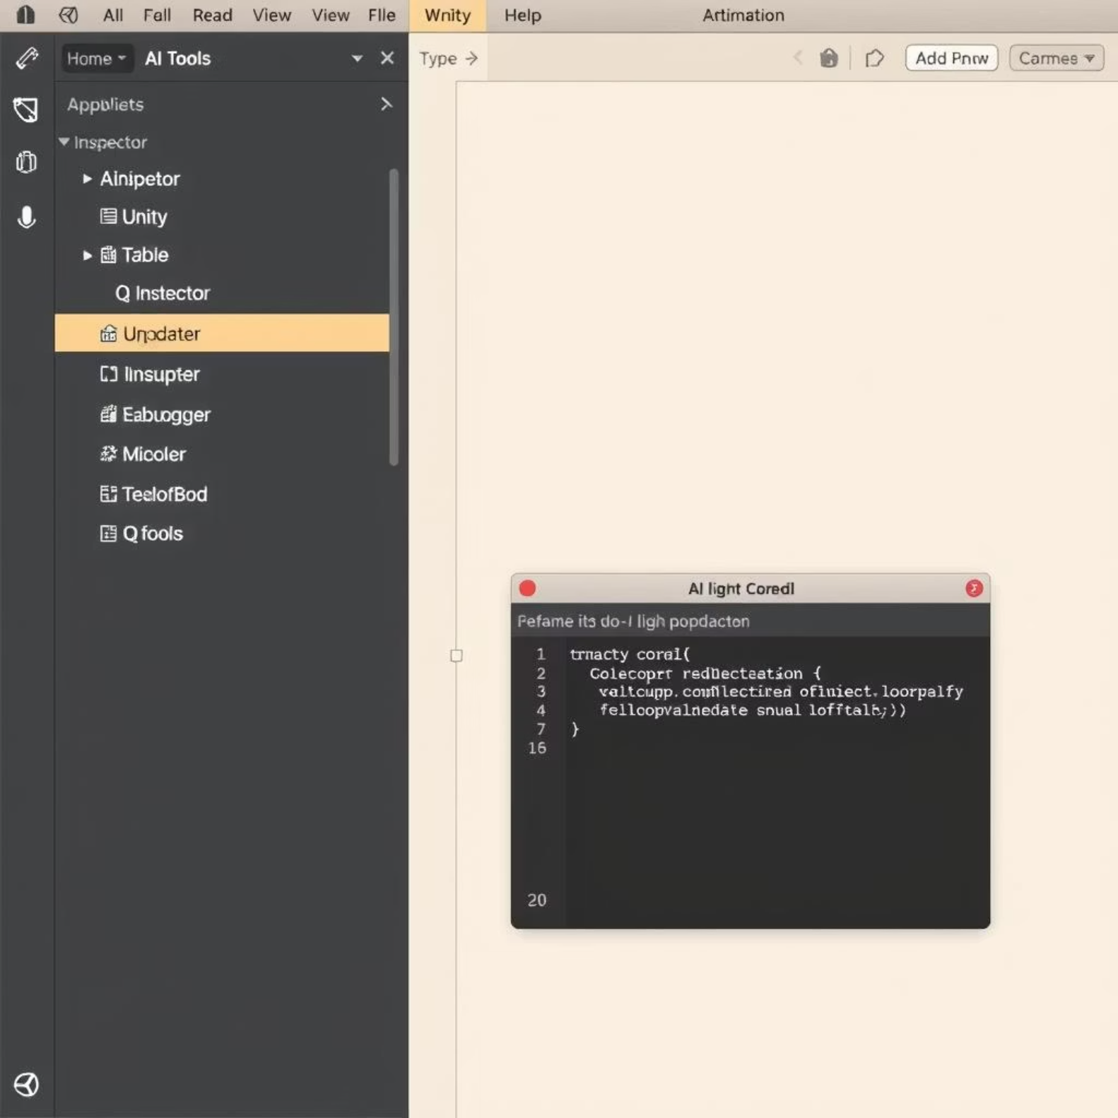



🛠️ Tools for Training, Debugging & Migration
We've developed a robust suite of custom tools and editor extensions to streamline the AI development workflow, from training and debugging to ensuring seamless API compatibility.
Overview
Code Snippet: Editor Script (Unity C#)
Custom tools built for training management and analysis.
[MenuItem("AI Tools/Force Retrain")]public static void ForceRetrainAI(){ AITrainer.RunTraining(episodes: 1000); Debug.Log("Training complete");}
Editor extensions for Unity, providing in-engine control.
Utility for API migration, ensuring compatibility with new libraries.
Integrated debugging and Q-table monitoring for insights.
Key Features
Force Retrain AI
One-click initiation of a new AI training cycle.
Q-Table Status Inspector
Real-time visualization of AI's learned states and values.
API Migration Fixer
Automated adjustments for library updates and breaking changes.
Editor Menu Integration
Streamlined access to all training, monitoring, and testing tools.

Slide 21
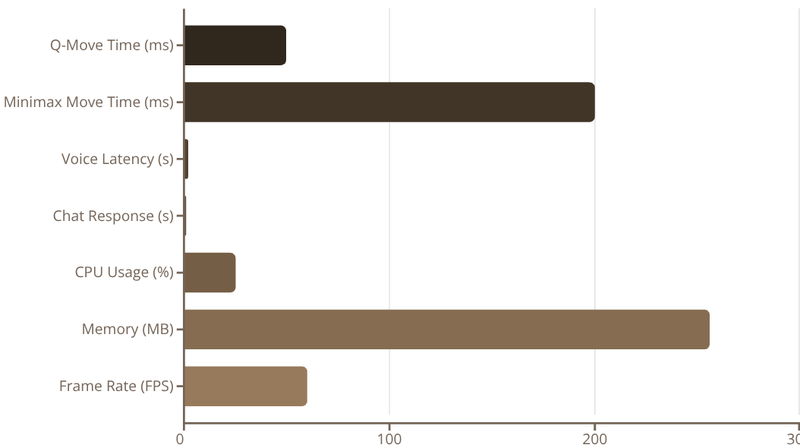

📊 AI Performance Metrics & Benchmarking
📈 Q-Learning Training Statistics
🧠 Style-Specific AI Performance
⚡ System & Technical Metrics
Episodes: 1,000State Space: 13,118+ observed statesConvergence: ~Episode 800Final ε (Exploration Rate): 0.1Q-Table Size: 142MBTraining Duration: ~15 minutes
Aggressive: 85% win vs Defensive 🏆Defensive: 90% survival in tight positionsWall Master: Avg. 8.5 walls/gameSpeed Runner: 20% faster completionTactical: 15% better positional control 🏆Balanced: Most stable across all matchups
Key Benefits
✔️ Reliable performance under pressure
✔️ Competitive AI across diverse styles
✔️ Real-time responsiveness for seamless interaction

Slide 22











🏆 Project Summary & Future Roadmap
✅ Project Achievements
🧠 Technical Innovations
Hybrid AI System
Combines Q-Learning and Minimax for robust gameplay.
Style-Specific Q-Tables
Customized learning data for each AI personality.
Diverse AI Personalities
6 distinct, separately trained AI styles for varied challenges.
Real-Time AI Fallback
Voice Interaction
Ensures smooth operation even under complex conditions.
Real-time speech-to-text and multi-platform text-to-speech.
Multi-Platform Chatbot
STT/TTS Switching
Integrated Rasa and Gemini for seamless, intelligent dialogue.
Dynamic selection of speech processing providers.
Efficient Q-Learning
Converged with 13,000+ states for strategic decision-making.
Local Offline Python AI
Enables AI gameplay without an internet connection.
Strong Performance
Achieved >95% win rate against random AI opponents.
Voice-Controlled Gameplay
Comprehensive Suite
Intuitive interaction for a hands-free experience.
Full testing and debugging tools for development efficiency.
🚀 Future Enhancements Roadmap
Deep Q-Networks (DQN)
Implementing neural networks for advanced learning.
Online Multiplayer
Introducing cloud-based matchmaking for global play.
AI Coaching Mode
Providing live strategic suggestions during gameplay.
Adaptive Opponent Modeling
AI learns and adapts to human play styles.
Custom Board Sizes
Expanding gameplay with 7x7 and 11x11 boards.
Vietnamese Chatbot
Localizing tutorial and analysis tools for new markets.
Final Impact Statement
"This project demonstrates how modern AI techniques — when combined with traditional game logic and seamless platform integration — can deliver a truly intelligent, interactive, and educational game experience."

Slide 23

Thank You for Your Attention!
Questions? Feedback? Let’s Discuss AI in Games.
🙏
AI QUORIDOR GAME PROJECT

